Slide 1
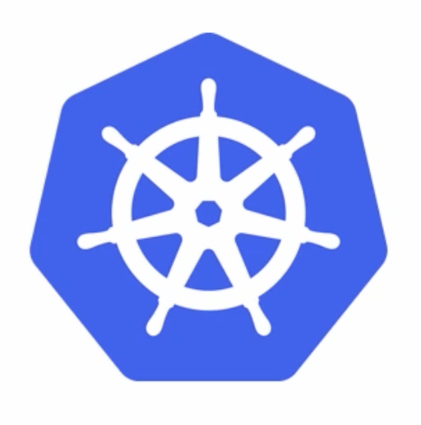
Kubernetes
July 21, 2017

Slide 2
Agenda
What is kubernetes
Kubernetes architecture
Big picture view
Masters
Nodes
Desired state and declarative model
Pods
Services
Demo

Slide 3
What is kubernetes
Greek for ’Helmsman’ – A person who steers the ship
Came out of Google
Written in Go/Golang
Kubernetes is all about managing containers at scale
Kubernetes automates the distribution and scheduling of application containers across a cluster in a more efficient way
Think of it as a courier – A package is dropped off at the courier
It is the hottest container platform technology

Slide 4
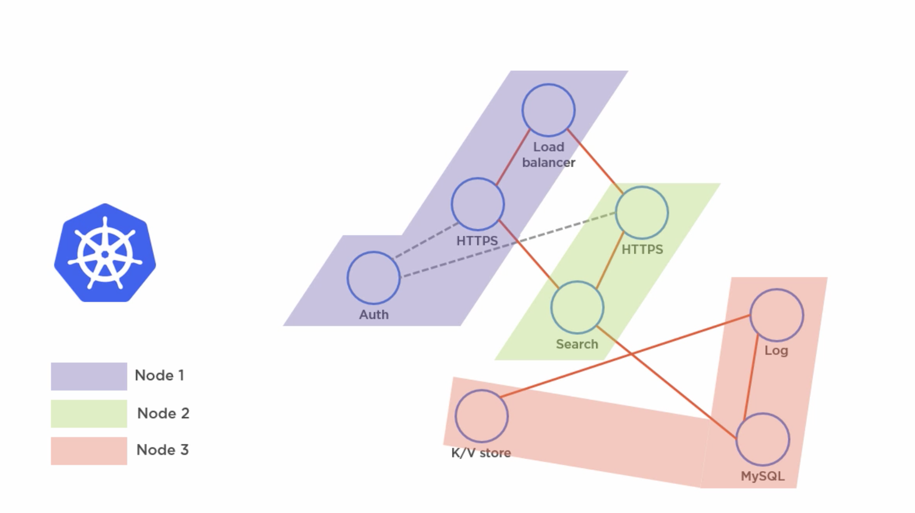
Architecture: the big picture
An orchestrator for Microservices app that runs on containers

Slide 5
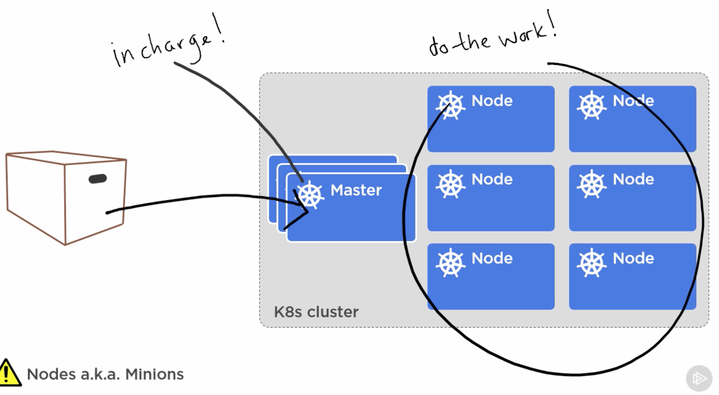
Architecture: the big picture
Application is packaged and give to the Master
Master is in charge and assigns the work to Nodes
Nodes are responsible for doing the actual work

Slide 6
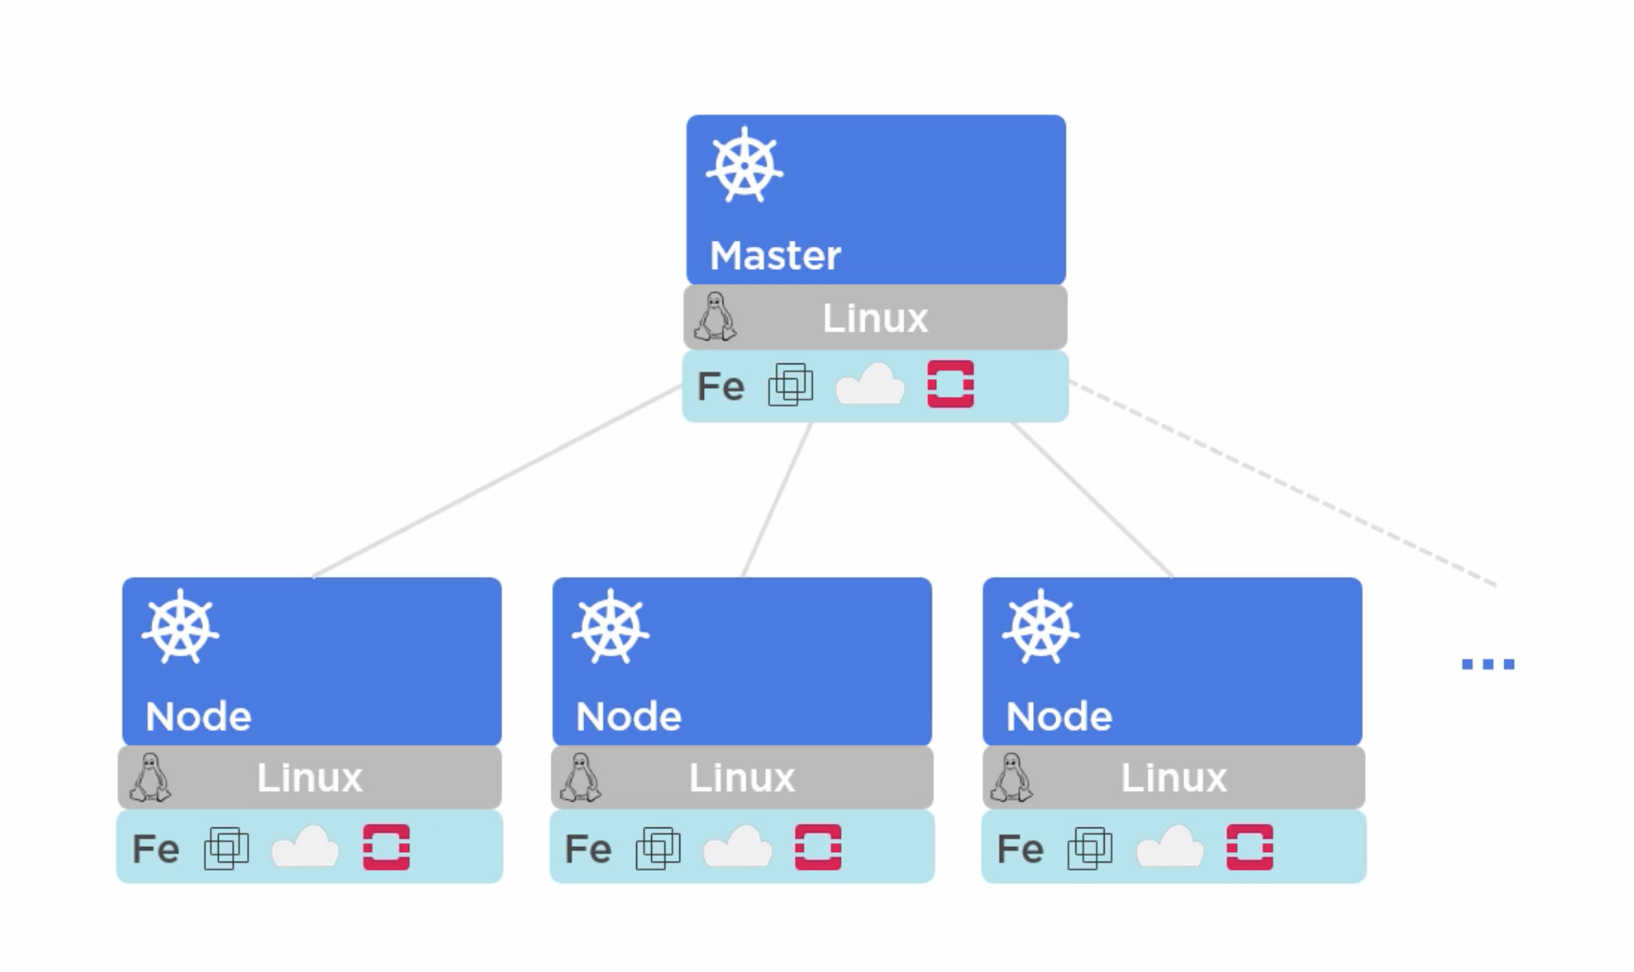
Architecture: masters
Kubernetes runs on Linux and doesn’t care what is underneath it, it could be VM, Cloud or an Openstack
Master should be free of user workloads
Its responsibility is looking after the cluster, and keeping things clean and simple

Slide 7
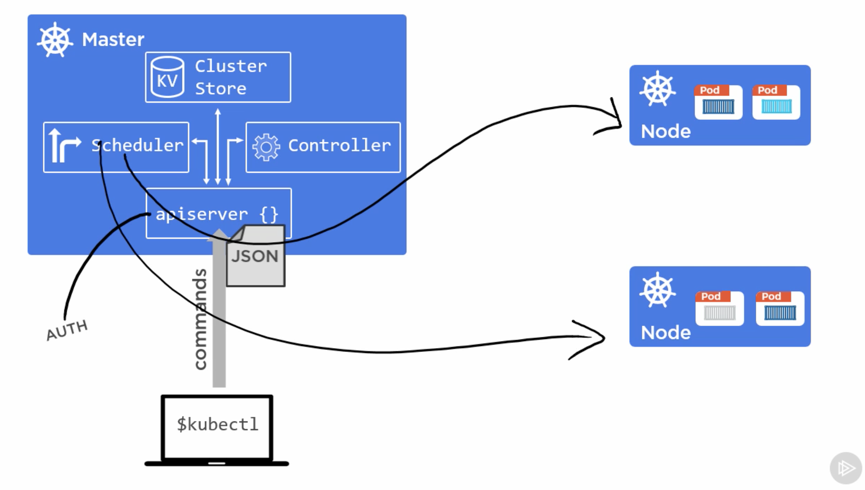
Architecture: masters
apiserver is the front end to the Master which exposes a RESTful API and consumes JSON, we as in the users issue commands to the apiserver
Cluster Store is a persistent storage for cluster state and config
Uses etcd for the source of truth for the cluster– etcd is a open source key-value store
Controller is the manager of all the controllers, also known as the controller of controllers
An example of a controller is the Replication Controller
Scheduler is responsible for watching the apiserver for new pods and assign work to nodes

Slide 8
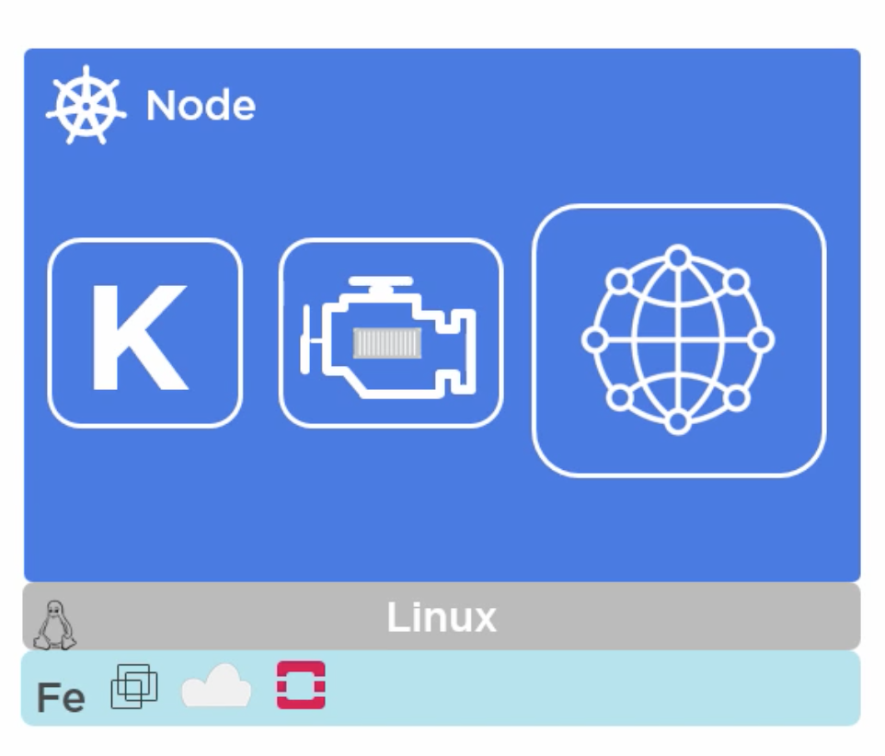
Architecture: nodes
Kublet
It is the main kubernetes agent on the node
Registers node on the cluster
Watches apiserver for work assignment
Responsible for instantiating pods
Reports back to the master, note that kublet is not responsible for a failed pod on the node, instead reports back to the master
Exposes end point on the port :10255, this end point helps you inspect the node, /spec, /healthz, /pods
Container Engine
Because there are containers in the pods, it needs a container runtime for example pulling images, starting and stopping containers etc..Usually Docker
Kube Proxy
This is the network brains of the node
All pods get unique ipaddress, if there are multiple containers in a pod, they all share a single ipaddress
Also does load balancing

Slide 9
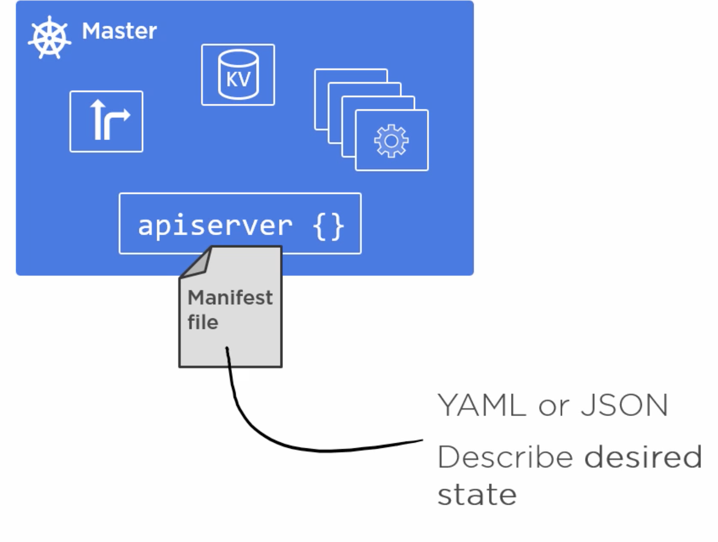
Architecture: DESIRED AND DECLARATIVE STATE
Kubernetes operates on a declarative model – we give the manifest file describing how we want the cluster to be configured
Whenever the actual state diverges from the desired state, k8s fixes it to bring it back to the desired state

Slide 10
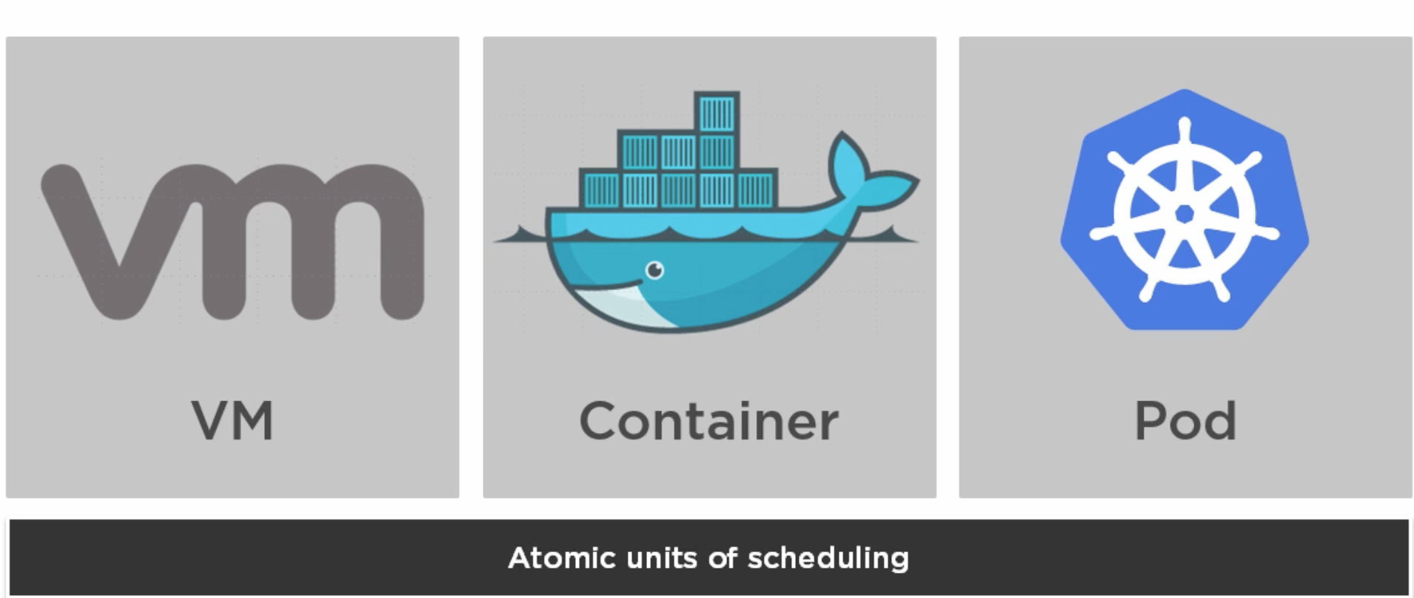
Architecture: PODS
In VMWare the atomic unit of deployment is the virtual machine, in the Docker world it is the container, well in k8s, it is the pod
Kubernetes run containers always inside pods
Pods can run more than one container in a pod

Slide 11
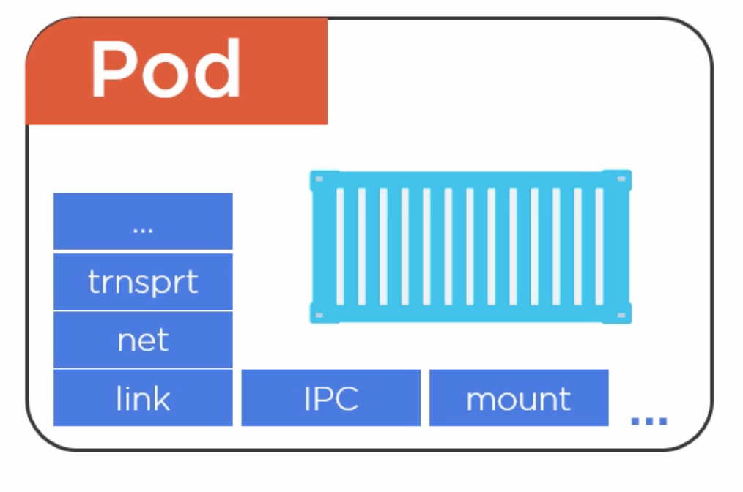
Architecture: PODS
Unit of scaling in k8s is always a pod, if you want scale a component in your app, you do it by adding or removing pods

Slide 12
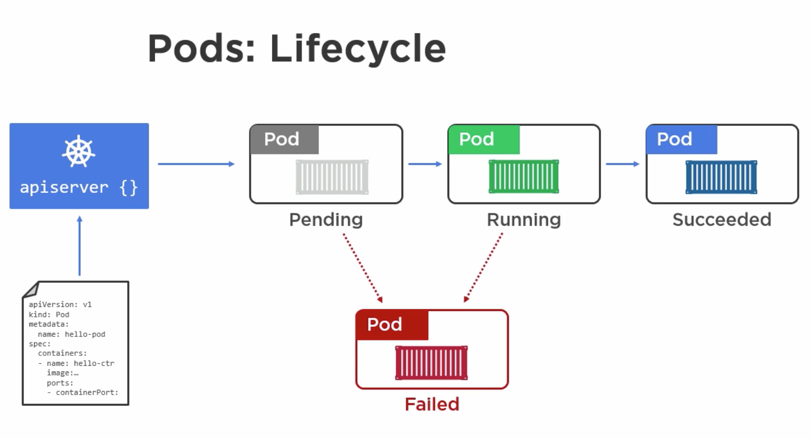
Architecture: PODS
Pods are atomic, they are either there or not there
A Pod is not available until all the containers are up and running
When a pod dies, the replication controller brings up a new pod

Slide 13
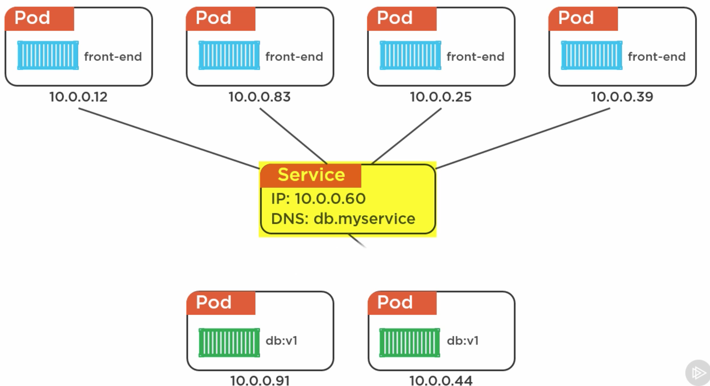
Architecture: SERVICES
Services are used to load balance and also address the high churn of IPs, as each pod has a unique IP.
Sends requests to only healthy pods
Services are configured using YAML files
Load balancing is totally random
Uses TCP by default

Slide 14
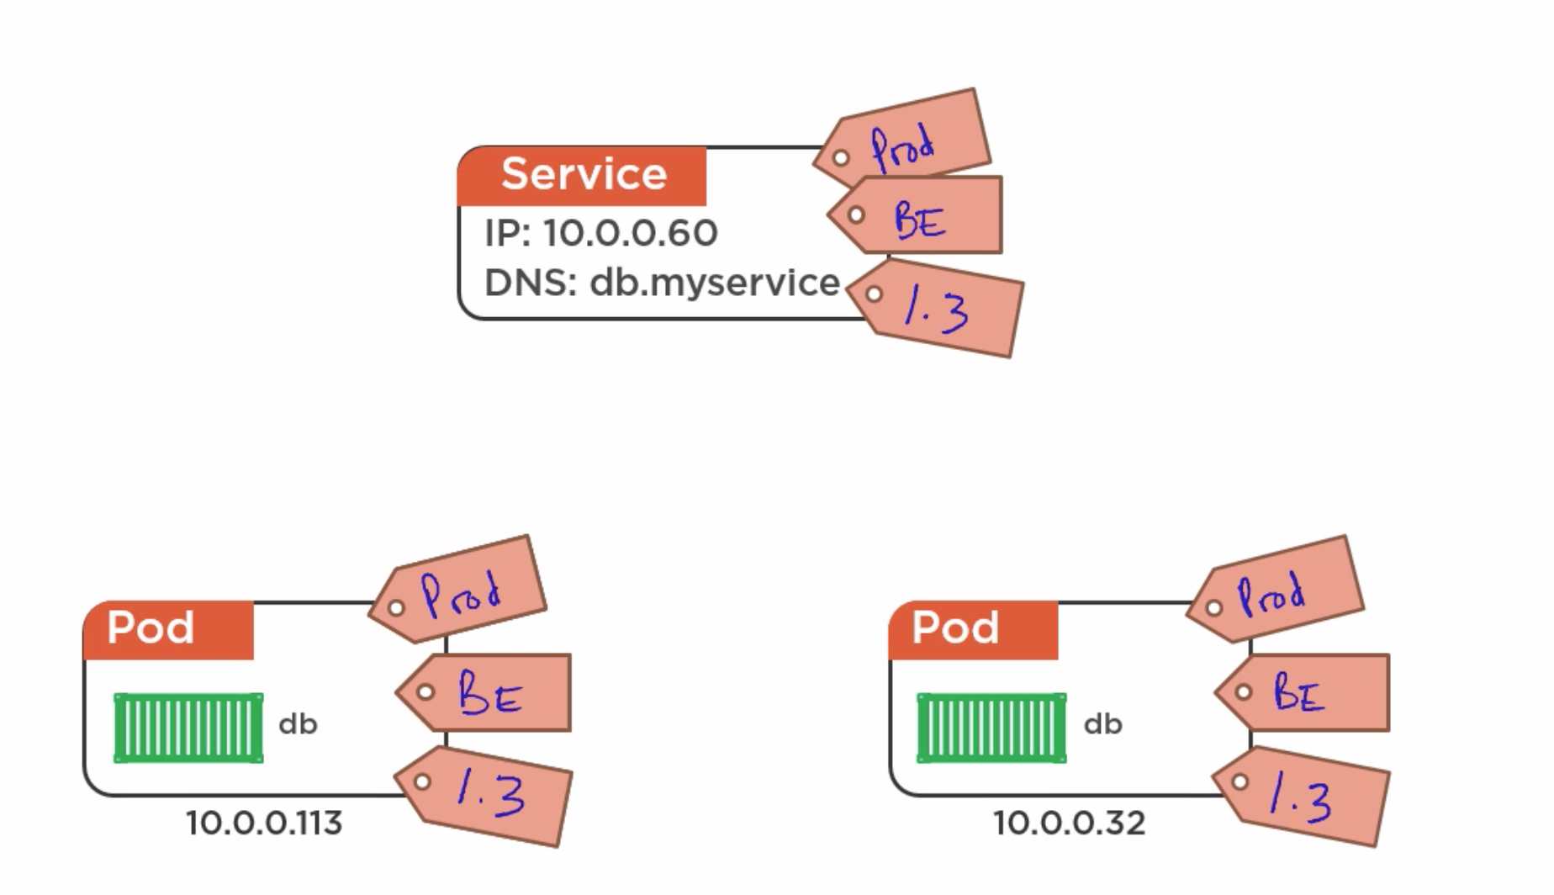
Architecture: SERVICES
Pods are tied to a Service via labels

Slide 15
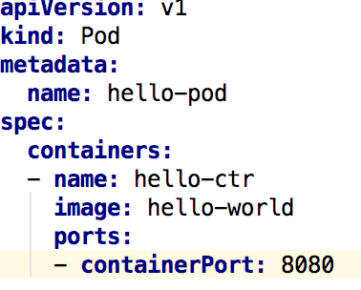
demo
Pre-requisite – Should have homebrew installed, if not follow the instructions at the following link:
https://brew.sh/
brew install kubectl
kubectl version –client
brew cask install minikube
brew install docker-machine-driver-xhyve
Do not forget to execute the following 2 commands
sudo chown root:wheel /usr/local/opt/docker-machine-driver-xhyve/bin/docker-machine-driver-xhyve
sudo chmod u+s /usr/local/opt/docker-machine-driver-xhyve/bin/docker-machine-driver-xhyve
minikube start –vm-driver=xhyve
kubectl config current-context (By switching contexts you can talk to any k8s cluster)
Kubectl get nodes
kubectl get pods
Create the YAML file as shown in the example
kubectl create -f pod.ym
minikube stop
minikube delete
minikube start –vm-driver=xhyve –kubernetes-version=“v1.6.0”
minikube get nodes
minikube dashboard

